Slide 1
Time Series
Marlabs

Slide 2
Table of Content
What is Time Series?
Stationary Time Series
Random Walk

Slide 3
What is Time Series?
Time series involves working on time (years, days, hours, minutes) based data, to derive hidden insights to make informed decision making.
Most of business houses work on time series data to analyze sales number for the next year, website traffic, competition position and much more.

Slide 4
Stationary Time Series
A stationary time series is one whose statistical properties such as mean, variance, autocorrelation, etc. are all constant over time.
Most statistical forecasting methods are based on the assumption that the time series can be rendered approximately stationary (i.e., "stationarized") through the use of mathematical transformations.

Slide 5
Three Criterion for a Time Series to be classified as stationary series
The mean of the series should not be a function of time rather should be a constant.
The variance of the series should not a be a function of time.
The covariance of the i^{th} term and the (i + m)^{th} term should not be a function of time.

Slide 6
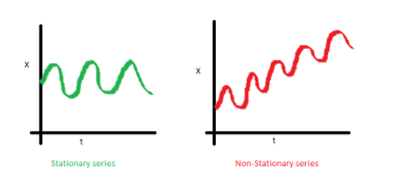
The mean of the series should not be a function of time rather should be a constant.

Slide 7
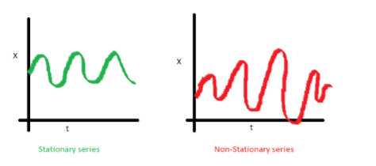
2. The variance of the series should not a be a function of time.

Slide 8
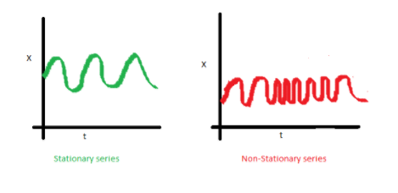
3. The covariance of the i th term and the (i + m) th term should not be a function of time.

Slide 9
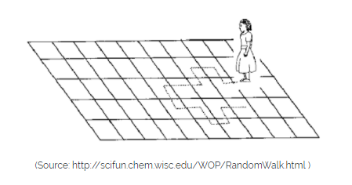
Random Walk
E.g., imagine a girl moving randomly on a giant chess board. Next Position of the girl only depends on the last position.

Slide 10
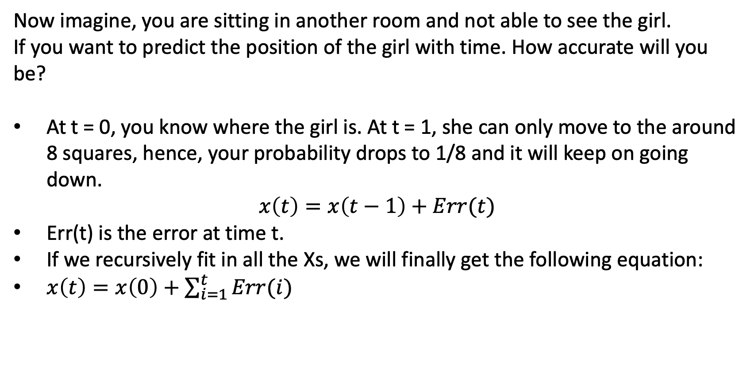
Now imagine, you are sitting in another room and not able to see the girl.
If you want to predict the position of the girl with time. How accurate will you be?
At t = 0, you know where the girl is. At t = 1, she can only move to the around 8 squares, hence, your probability drops to 1/8 and it will keep on going down.
$$x\left(t\right)=x\left(t−1\right)+Err(t)$$
Err(t) is the error at time t.
If we recursively fit in all the Xs, we will finally get the following equation:
$x\left(t\right)=x\left(0\right)+\sum_{i=1}^{t}{Err(i)}$

Slide 11
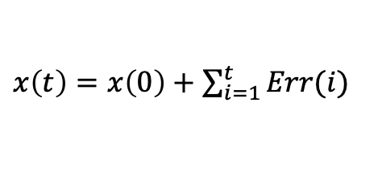
Validating Assumptions on Random Walk
Is the mean constant?
The expectation of any error will be zero as it is random.
Hence, we get E[x(t)] = E[x(0)] = constant
$x\left(t\right)=x\left(0\right)+\sum_{i=1}^{t}{Err(i)}$

Slide 12
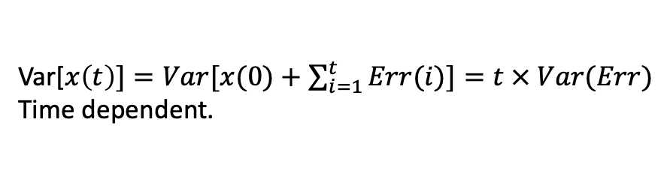
Validating Assumptions on Random Walk
2. Is the variance constant?
Hence, we infer that the random walk is not a stationary process as it has a time variant variance.
Also, if we check the covariance, it is also dependent on time.
Var[$x\left(t\right)]=Var[x(0)+\sum_{i=1}^{t}{Err(i)]=t × Var(Err)}$
Time dependent.

Slide 13
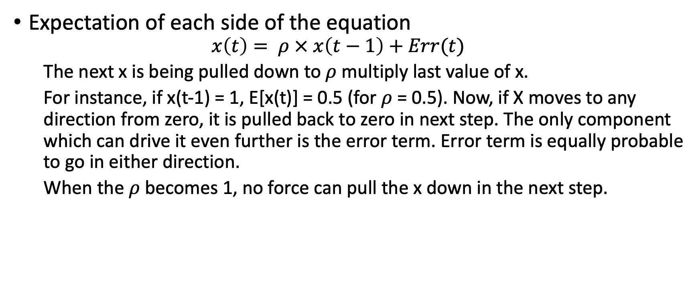
Dickey Fuller Test of Stationarity
Expectation of each side of the equation
$$x\left(t\right)= ρ × x\left(t−1\right)+Err(t)$$
The next x is being pulled down to $ρ$ multiply last value of x.
For instance, if x(t-1) = 1, E[x(t)] = 0.5 (for $ρ$ = 0.5). Now, if X moves to any direction from zero, it is pulled back to zero in next step. The only component which can drive it even further is the error term. Error term is equally probable to go in either direction.
When the $ρ$ becomes 1, no force can pull the x down in the next step.

Slide 14
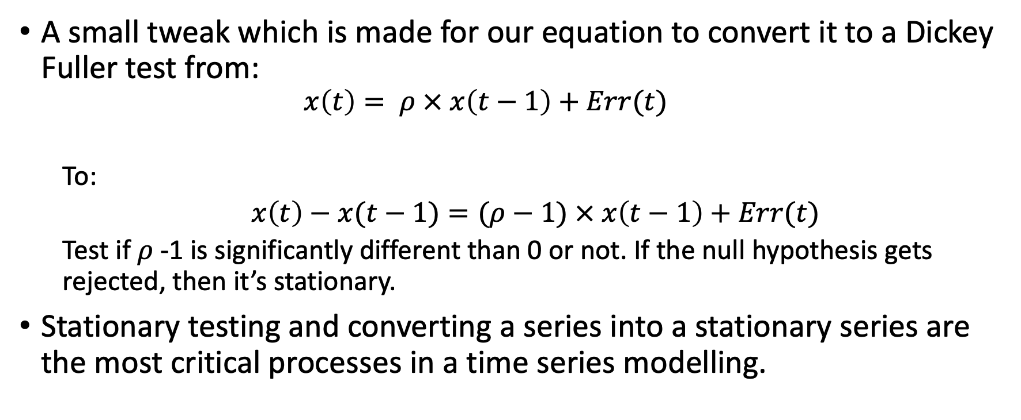
Dickey Fuller Test of Stationarity
A small tweak which is made for our equation to convert it to a Dickey Fuller test from:
$$x\left(t\right)= ρ × x\left(t−1\right)+Err(t)$$
To:
$x\left(t\right)−x(t−1)=(ρ−1) × x\left(t−1\right)+Err(t)$
Test if $ρ$ -1 is significantly different than 0 or not. If the null hypothesis gets rejected, then it’s stationary.
Stationary testing and converting a series into a stationary series are the most critical processes in a time series modelling.

Slide 15
How to make a Time Series Stationary?
Two Major Aspects:
Trend – varying mean over time. For eg, in this case we saw that on average, the number of passengers was growing over time.
Seasonality – variations at specific time-frames. eg people might have a tendency to buy cars in a particular month because of pay increment or festivals.

Slide 16
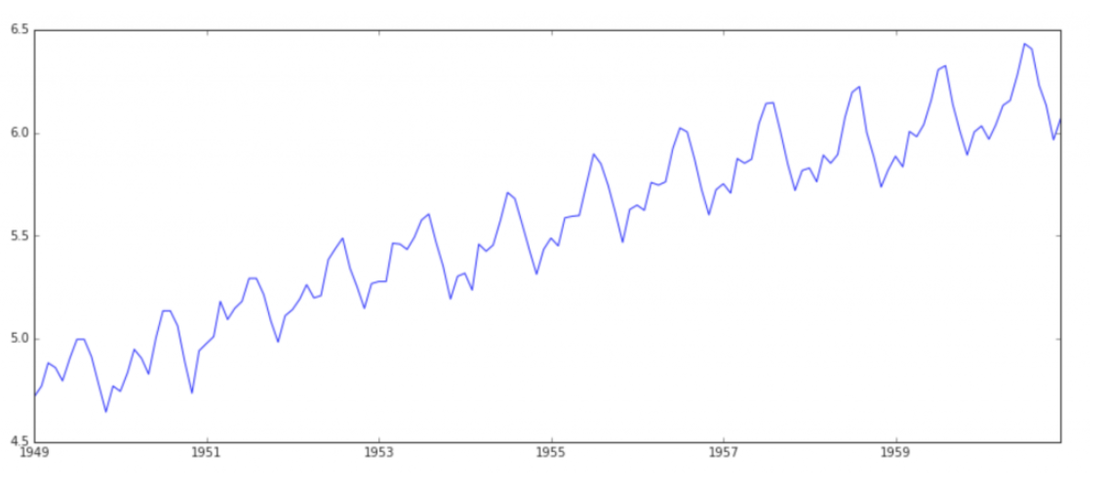
Estimating & Eliminating Trend
One of the first trick to reduce trend can be transformation.
We can apply transformation which penalize higher values more than smaller values. These can be taking a log, square root, cube root, etc.

Slide 17
Aggregation – taking average for a time period like monthly/weekly averages
Smoothing – taking rolling averages
Polynomial Fitting – fit a regression model

Slide 18
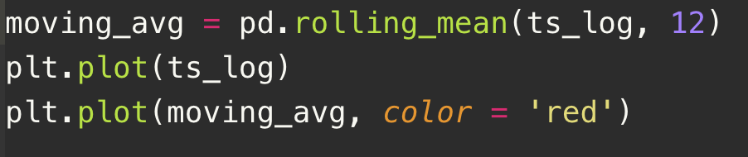
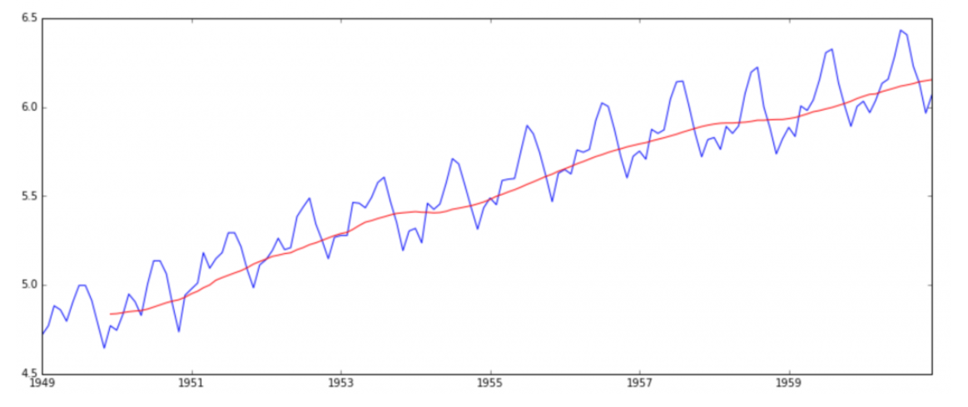
Moving Average
Take average of k consecutive values depending on the frequency of time series.

Slide 19
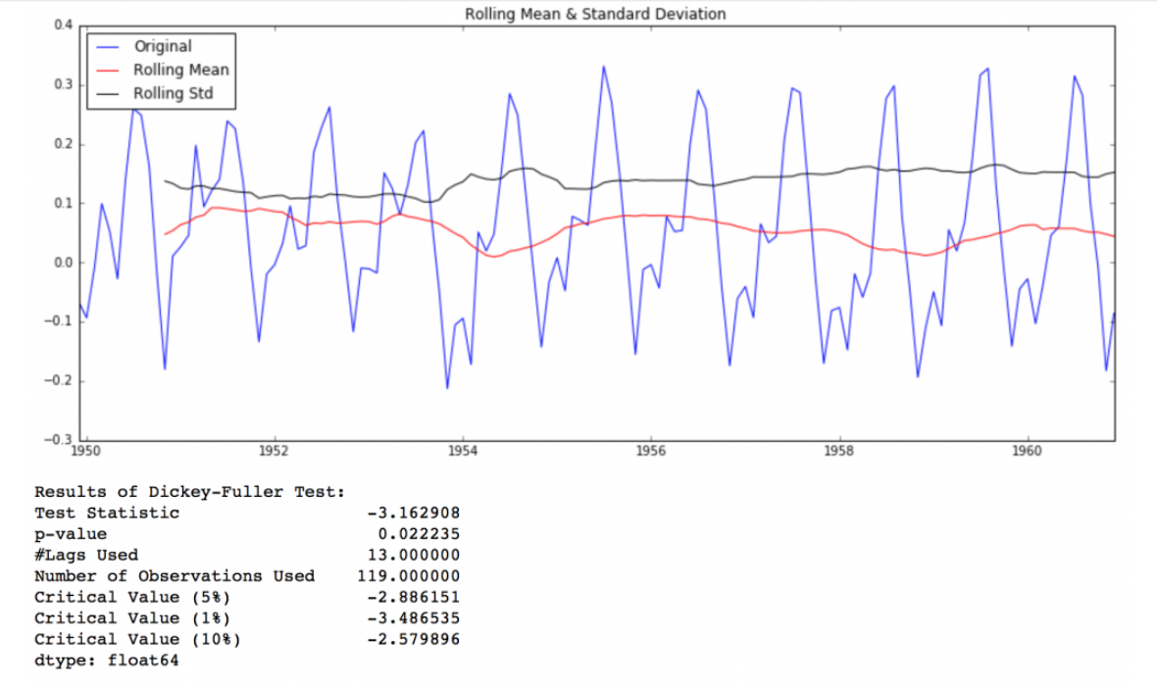
Lets subtract this from the original series. Note that since we are taking average of last 12 values, rolling mean is not defined for first 11 values.
The test statistic is smaller than the 5% critical values so we can say with 95% confidence that this is a stationary series.

Slide 20
Moving Average
Drawback: the time-period has to be strictly defined.
Other approach:
Take weighted moving average where more recent values are given a higher weight.
Exponential weighted moving average where weights are assigned to all the previous values with a decay factor.

Slide 21
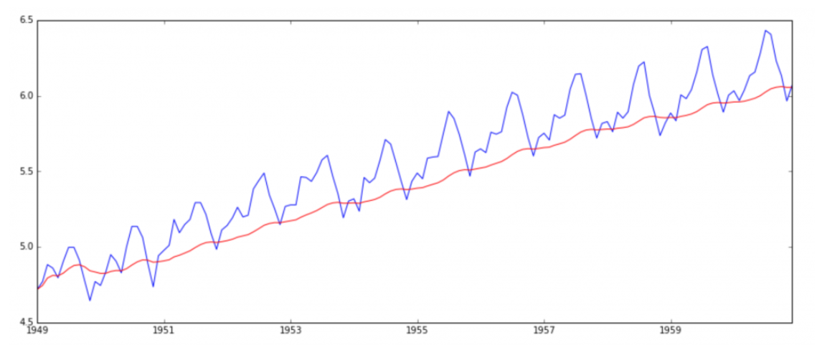
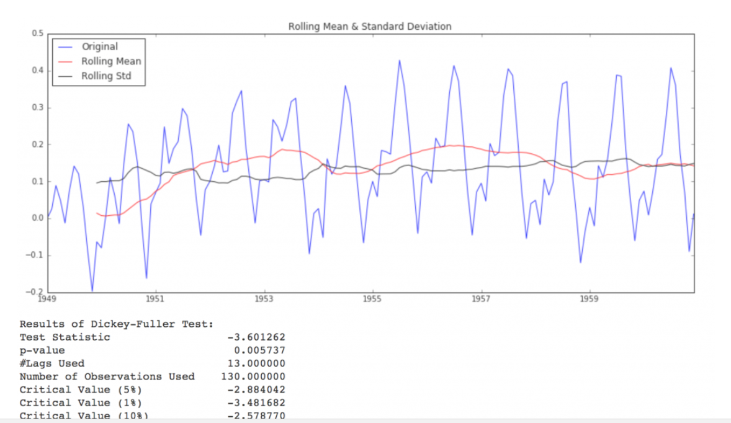

Slide 22
Eliminating Trend and Seasonality
Two ways of removing trend and seasonality:
Differencing – taking the difference with a particular time lag
Decomposition - modeling both trend and seasonality and removing them from the model.

Slide 23
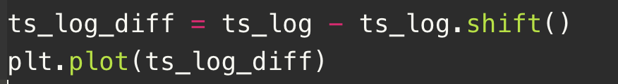
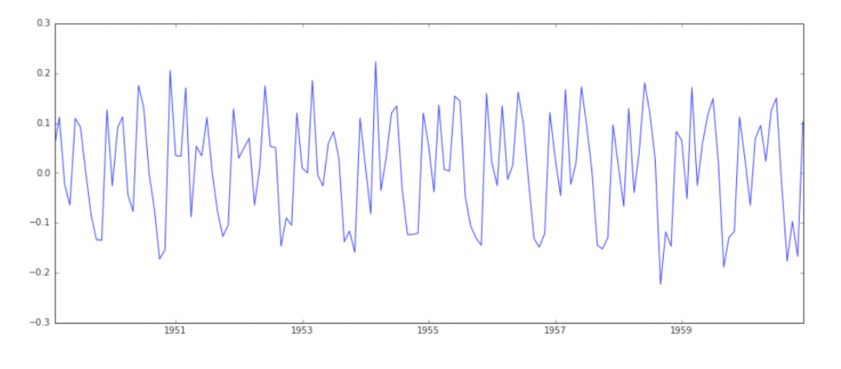
Eliminating Trend and Seasonality 1. Differencing
Differencing:
Take the difference of the observation at a particular instant with that at the previous instant.
First order differencing can be done in pandas as right:

Slide 24
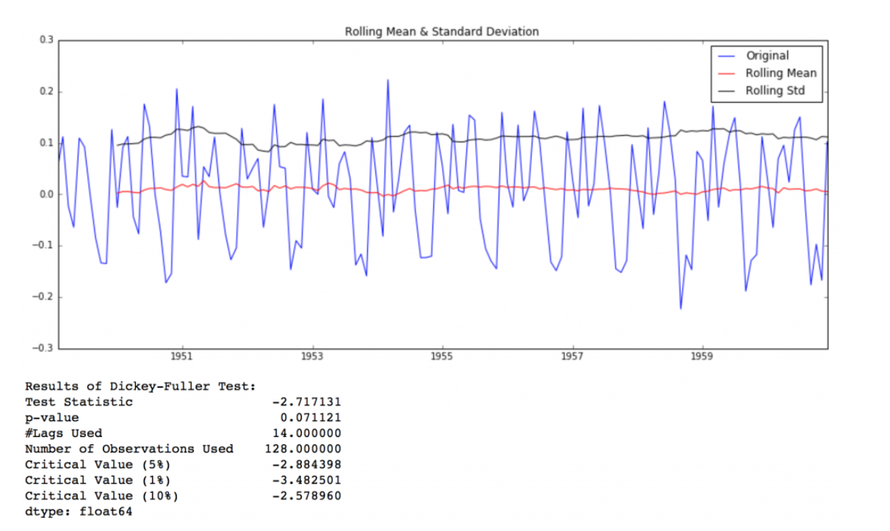
Eliminating Trend and Seasonality 1. Differencing
The rolling mean and rolling std have small variations with time.
Also, the Dickey-Fuller test statistic is less than the 10% critical value, thus the TS is stationary with 90% confidence.
We can also take second or third order differences which might get even better results in certain applications.

Slide 25
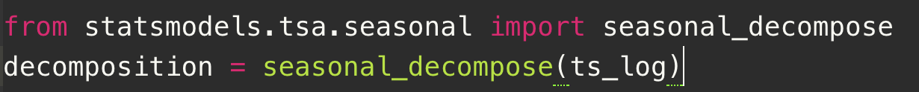
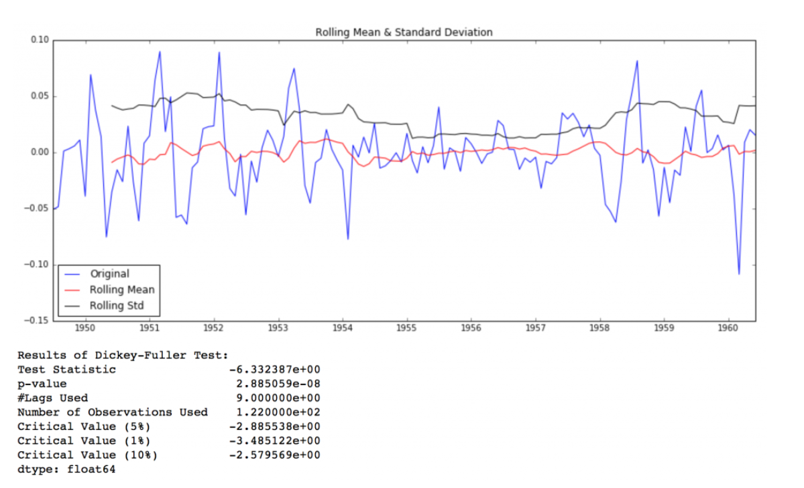
Eliminating Trend and Seasonality 2. Decomposing

Slide 26
Forecasting a Time Series
A strict stationary series with no dependence among the values:
This is a easy case wherein we can model the residuals as white noise. But this kind of situation is very rare.
A series with significant dependence among values:
In this case, we need to use some statistical models such as ARIMA to do the forecast.

Slide 27
ARIMA
ARIMA stands for Auto-Regressive Integrated Moving Averages.
The ARIMA forecasting for a stationary time series is nothing but a linear (like a linear regression) equation.
The predictors depend on the parameters (p,d,q) of the ARIMA model:
Number of AR (Auto-Regressive) terms (p): AR terms are just lags of dependent variable. For instance if p is 5, the predictors for x(t) will be x(t-1)….x(t-5).
Number of MA (Moving Average) terms (q): MA terms are lagged forecast errors in prediction equation. For instance if q is 5, the predictors for x(t) will be e(t-1)….e(t-5) where e(i) is the difference between the moving average at i^{th} instant and actual value.
Number of Differences (d): These are the number of non-seasonal differences, i.e. in this case we took the first order difference. So either we can pass that variable and put d=0 or pass the original variable and put d=1. Both will generate same results.

Slide 28
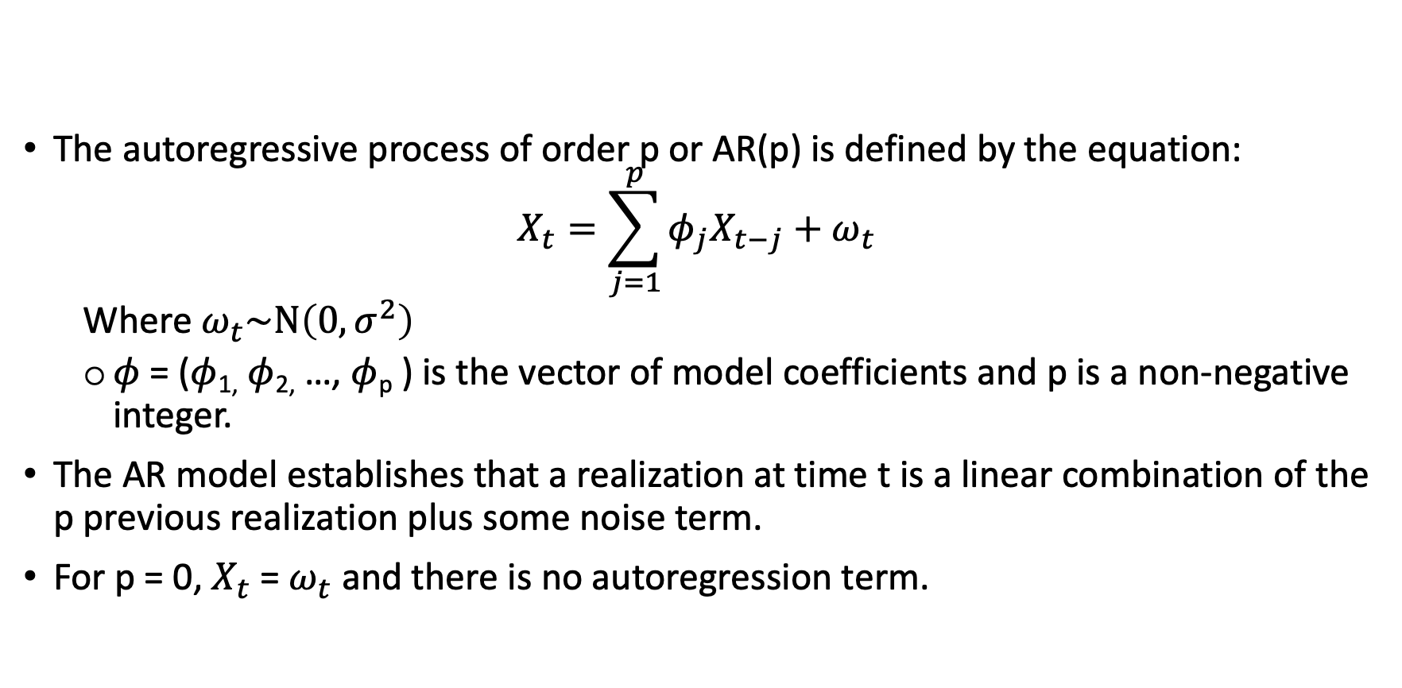
AR
The autoregressive process of order p or AR(p) is defined by the equation:
$$X_{t}=\sum_{j=1}^{p}{φ_{j}X_{t−j}+ω_{t}}$$
Where $ω_{t}\sim N\left(0, σ^{2}\right)$
$φ$ = ($φ$_{1,} $φ$_{2,} …, $φ$_{p} ) is the vector of model coefficients and p is a non-negative integer.
The AR model establishes that a realization at time t is a linear combination of the p previous realization plus some noise term.
For p = 0, $X_{t}$ = $ω_{t}$ and there is no autoregression term.

Slide 29
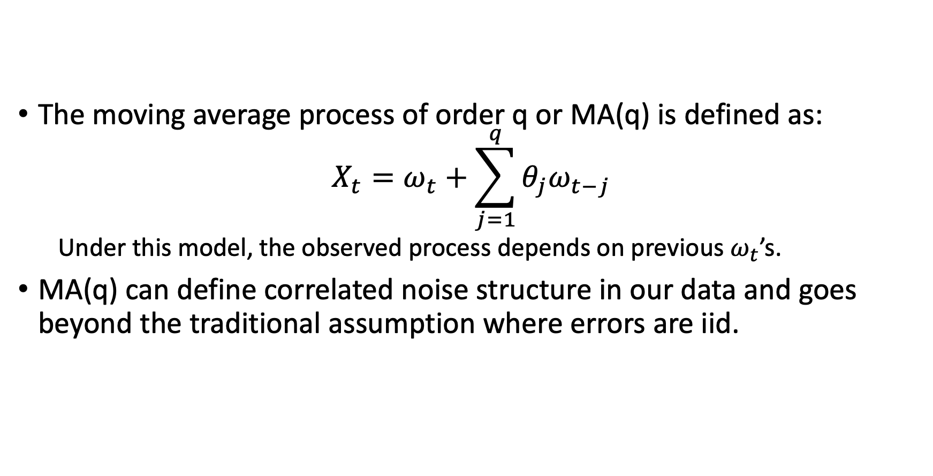
MA
The moving average process of order q or MA(q) is defined as:
$$X_{t}=ω_{t}+\sum_{j=1}^{q}{θ_{j}ω_{t−j}}$$
Under this model, the observed process depends on previous $ω_{t}$’s.
MA(q) can define correlated noise structure in our data and goes beyond the traditional assumption where errors are iid.

Slide 30
How to determine the value of ‘p’ and ‘q’
Autocorrelation Function (ACF): It is a measure of the correlation between the TS with a lagged version of itself. For instance at lag 5, ACF would compare series at time instant t₁, t₂ with series at instant t_{1-5,} t₂₋₅ (t₁₋₅ and t₂ being end points).
Partial Autocorrelation Function (PACF): This measures the correlation between the TS with a lagged version of itself but after eliminating the variations already explained by the intervening comparisons. E.g. at lag 5, it will check the correlation but remove the effects already explained by lags 1 to 4.

Slide 31
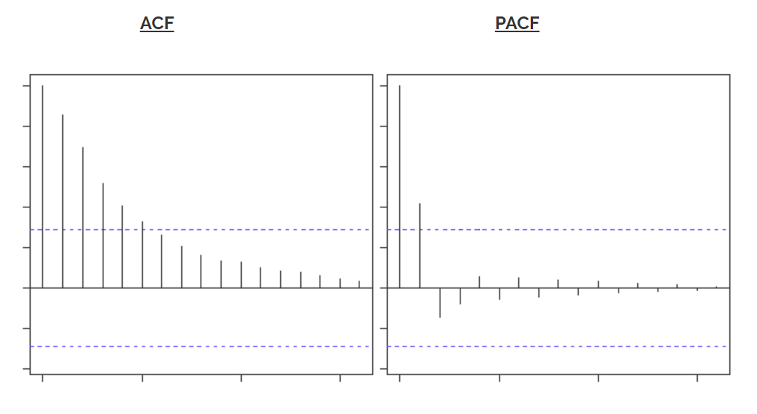
Is it an AR or MA process?
Clearly, the graph has a cut off on PACF curve after 2nd lag which means this is mostly an AR(2) process.

Slide 32
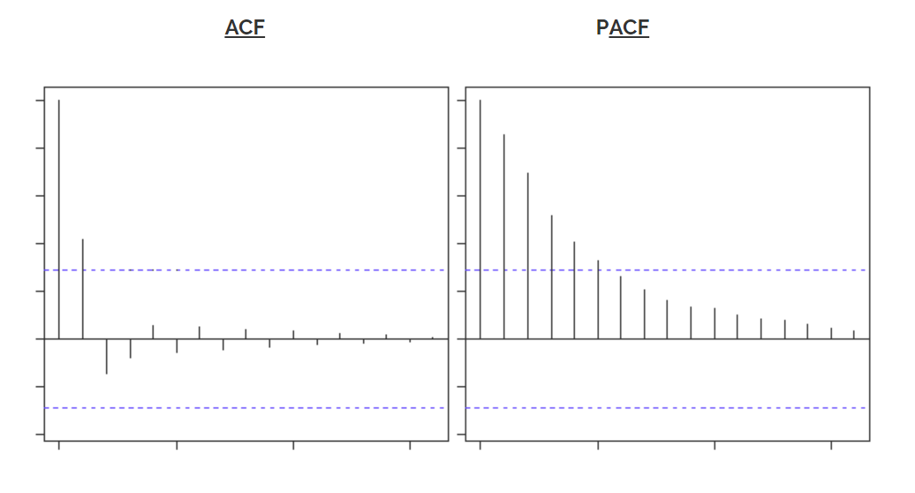
The left graph has a cut off on ACF curve after 2nd lag which means this is mostly a MA(2) process.

Slide 33
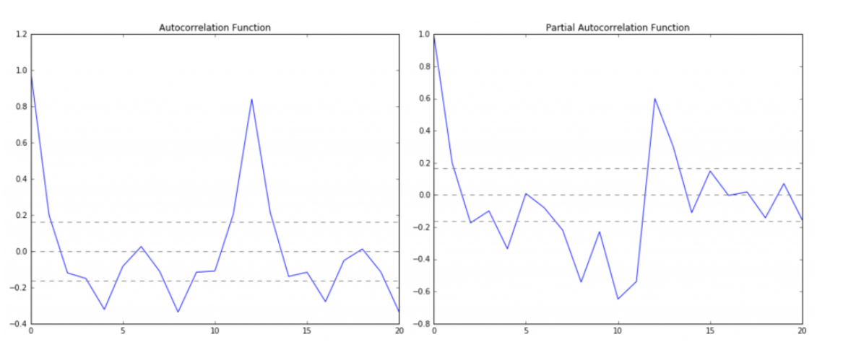
p – The lag value where the PACF chart crosses the upper confidence interval for the first time. If you notice closely, in this case p=2. q – The lag value where the ACF chart crosses the upper confidence interval for the first time. If you notice closely, in this case q=2.

Slide 34
ARIMA in statsmodels
Package: statsmodels.tsa.arima_model has ARIMA
The p,d,q values can be specified using the order argument of ARIMA which takes a tuple (p, d, q).

